Slide 1

Artificial Intelligence Programming Practice
Lecturer ： Rao Yunbo
University of Electronic Science and Technology of China ·
School of Information and Software Engineering
University of Electronic Science and Technology of China,
Chengdu, China , April 1, 2024

Slide 2
Chapter 6 Expansion of semantic segmentation

Slide 3
课程主要部分
01
SAM algorithm
outline
02
SAM experiment
03
SAM applications

Slide 4
01
SAM algorithm

Slide 5
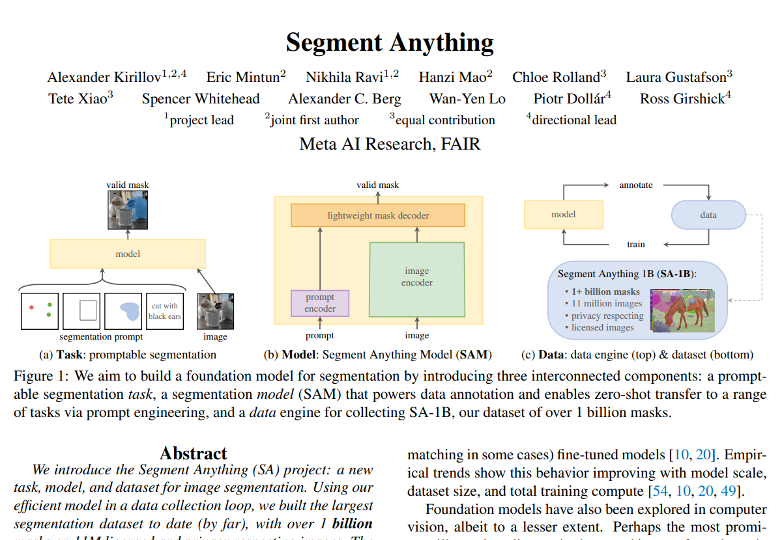
Segment Anything Model (SAM)
SAM：MetaAI Proposed Image Segmentation Large Model
The original paper was published in ICCV 2023

Slide 6
Segment Anything (SAM)
Network Dataset
+
Large Language Model (LLM)
+
Prompt Engineering
The powerful zero shot and few shot generalization abilities, as the "basic model," can be extended to tasks and data distributions beyond the training process
Can this training method be extended to visual tasks?
The purpose of developing SAM is to establish a basic model for image segmentation and develop a model with prompt ability.
Notes:
在网络数据集上预训练的大语言模型具有强大的zero-shot(零样本)和few-shot(少样本)的泛化能力，这些"基础模型"可以推广到超出训练过程中的任务和数据分布，这种能力通过“prompt engineering”实现，具体就是输入提示语得到有效的文本输出，使用网络上的大量文本资料库进行缩放和训练后，发现这种零样本和少样本的训练的模型比微调模型效果还要好，数据集越大，效果越明显。
视觉任务上也对这种基础模型进行了探索，比如CLIP和ALIGN利用对比学习，将文本和图像编码进行了对齐，通过提示语生成image encoder，就可以扩展到下游任务，比如生成图像。
论文的目的是建立一个图像分割的基础模型，开发一个具有提示能力的模型。

Slide 7
Segment Anything (SAM)
Three unresolved issues: task, model, and data
What task can achieve zero sample generalization?
What is the corresponding model architecture?
What data can support this task and model?
Notes:
3个待解决的问题：任务，模型，数据
什么任务可以实现零样本泛化？
相应的模型架构是什么？
什么数据可以支持此任务和模型？

Slide 8
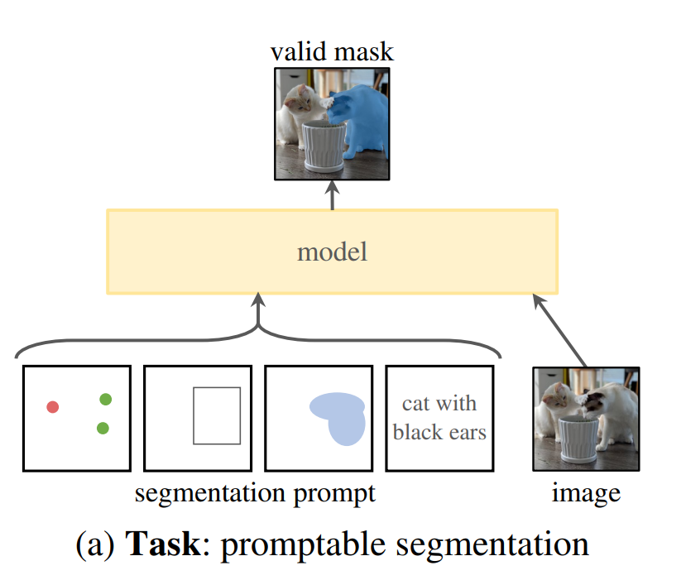
Segment Anything (SAM)
What task can achieve zero samples?
Generate a valid mask by prompting input. When the prompt is unclear, multiple objects can be generated (such as a point on the clothing, which can represent both the clothing and the person wearing it).
As shown in Figure: the prompt can be a point, a rectangular box, or text, mask， or it could be an image.
Notes:
（1）什么任务可以实现零样本？
通过提示(prompt)输入，生成有效的mask。当提示是不明确的时候，能生成多个objects (比如衣服上的一个点，既可以表示衣服，也表示穿衣服的人)，如下图所示：提示可以是点，矩形框，文字，mask，或者是图像。

Slide 9
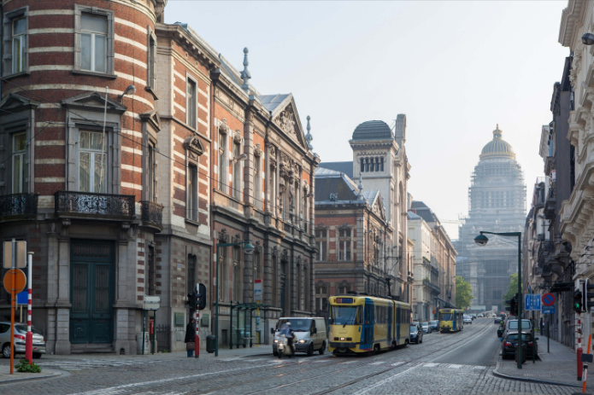
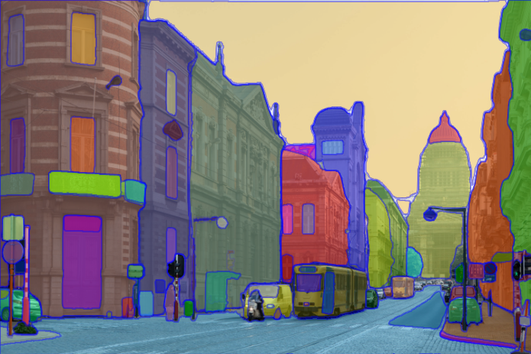
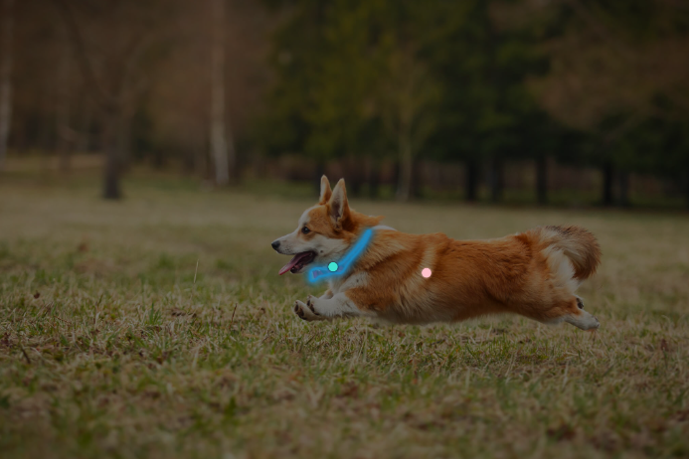
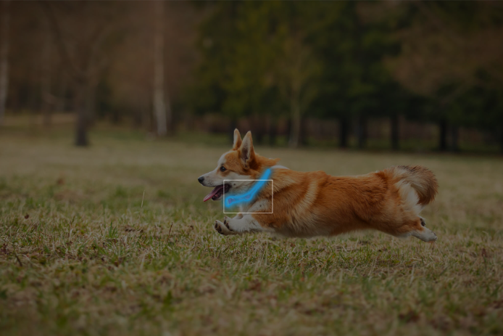
Segment Anything (SAM)
（1） What task can achieve zero samples?
Promptable Segmentation Task
image
everything
box
points
Notes:
（1）什么任务可以实现零样本？

Slide 10
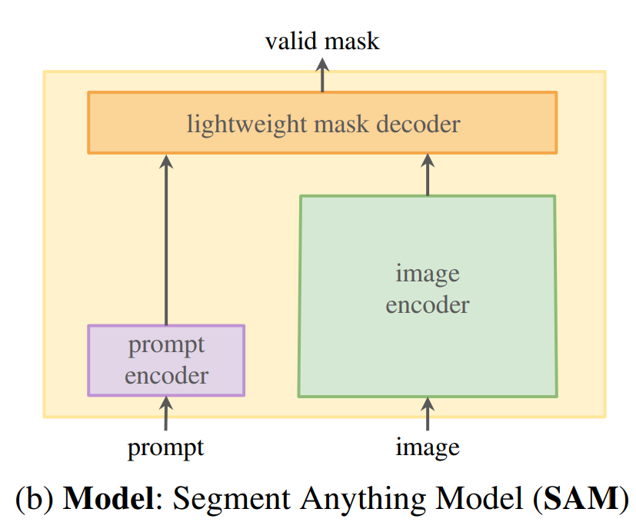
Segment Anything (SAM)
(2) What should the model structure be like?
The model should support flexible prompts, generate masks in real-time, and the output can also be fuzzy (such as representing clothes or people wearing clothes). The design structure is as follows: a prompt encoder that encodes prompts; Image encoder encodes images and generates embeddings; Finally, merge two encoders, followed by a lightweight mask decoder, and output the final mask
Notes:
（2）模型结构应该是什么样？
模型要支持灵活的提示，且要实时生成mask，输出也可以是模糊的 (比如表示衣服还是穿衣服的人)。设计结构如下：一个prompt encoder，对提示进行编码；image encoder对图像编码，生成embedding； 最后融合2个encoder，再接一个轻量的mask decoder，输出最后的mask

Slide 11
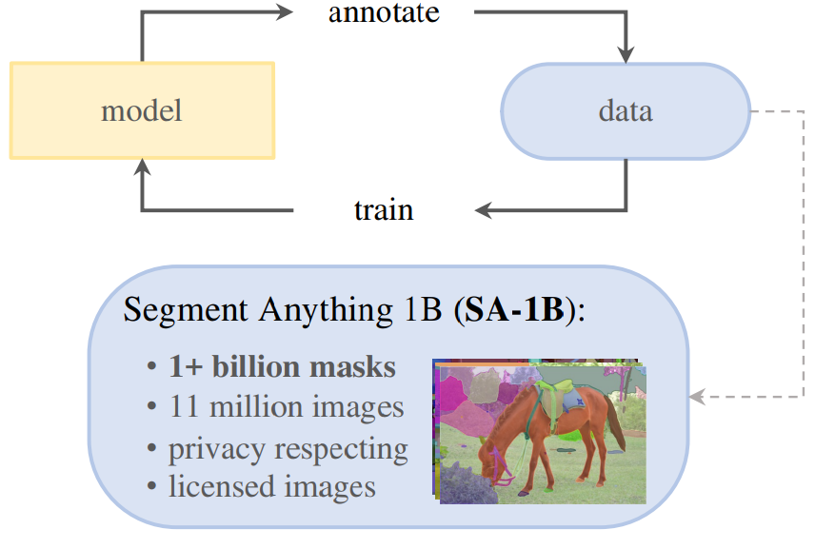
Segment Anything (SAM)
(3) How does the data support these tasks?
A large and diverse mask data is required. Natural language data is obtained online, but mask data is insufficient and requires an alternative strategy.
First, manually annotation the data to train the model. When the model is trained to a similar level, use the model to assist in annotating the data, and thus establish a data loop: training + annotation.
In the end, 1 billion masks were generated from 11 million images, which is currently the largest segmentation dataset and 400 times more masks than the existing dataset.
Notes:
（3）数据怎么支持这些任务？
需要一个大量且多样化的mask数据。自然语言数据是通过在线获取，但是mask数据是不足的，需要一个替代策略。
如下图所示：先人工标注数据训练模型，当模型训练得差不多的时候，再用模型辅助标注数据，如此建立一个数据循环：训练+标注。最终从1100万张图像中生成了10亿的mask，是当前最大的分割数据集，比当前已有的数据集多了400倍的mask。

Slide 12
Segment Anything (SAM)
(3) How does the data support these tasks?
The specific plan is to establish a "data engine", which is divided into three steps:
Auxiliary manual annotation(helping with annotation, similar to interactive segmentation)
semi-automatic (generating object masks automatically by providing prompts)
and fully automatic (generating objects automatically by using a regular grid as prompts)
Notes:
（3）数据怎么支持这些任务？
具体方案是建立一个“数据引擎”，分成3步：人工辅助 (帮助标注，类似交互式分割)，半自动 (通过提供提示，自动生成对象mask)，全自动（通过规则格网作为提示，进行自动生成）。

Slide 13
Segment Anything (SAM)
Data engine
Auxiliary manual annotation
Annotate using SAM's browser based interactive segmentation tool and "brush" and "eraser" tools. The model can output masks in real-time. It is recommended that annotators prioritize marking the objects they named and mark them in layer order. If a mask is marked for more than 30 seconds, the next one should be processed first.
SAM is first trained using publicly available datasets, and then trained using newly added annotation masks. As the amount of data increases, the stronger the ability of the image encoder, retrained 6 times.
With the improvement of the model, the average annotation time for each mask increased from 34s to 14s, and the average number of masks per image increased from 22 to 44. During this process, 4.3 million masks were collected from 120000 images.
Notes:
(1) 辅助人工标注
通过SAM基于浏览器的交互式分割工具，通过“brush”和"eraser"工具，进行标注。模型可以实时输出mask，建议标注者优先标记他们命名的对象，按图层顺序标记，如果一个mask标记超过30s，先处理下一张。
SAM先用公开数据集训练，然后再用新增的标注mask训练。随着数据越多，image-encoder的能力越强，retrained了6次。随着模型改进，每个mask平均标注时间从34s到14s，平均每张图像mask从22增加到44个。在这个过程中，从12万图像中，收集了430万个mask。

Slide 14
Segment Anything (SAM)
Data engine
(2) Semi automatic annotation
To increase the diversity of masks, first detect trustworthy masks, and then fill the image with predicted masks, allowing annotators to annotate unmarked masks.
During the semi-automatic process, 5.9 million masks were generated from 180000 images. By using newly collected data and retraining the model, the average annotation time has returned to 34 seconds, as the new masks are quite challenging. The mask on each image has increased from 44 to 72.
Notes:
数据引擎（data engine ）
(2) 半自动标注
增加mask的多样性，首先检测出可信的mask，然后用预测mask填充图像，让标注者标注未标记的mask。
半自动过程中，从18万张图像中生成了590万个mask。用新收集的数据，重新训练模型，平均标注时间又回到了34s,因为新的mask都是比较有难度的。每张图像上mask从44增加到72。

Slide 15
Segment Anything (SAM)
Data engine
(3) Fully automatic
By utilizing the large number and diversity of masks obtained in the first two steps, combined with the model, effective masks can be output based on unclear inputs. (32,32) grid points are generated on the image, and a series of masks are predicted for each point. If a point falls on a part or sub part, the model returns the object of the part, sub part, and whole.
In order to improve the quality of the mask for small targets, we also crop the image by enlarging it to handle situations where multiple masks cover.
On a dataset of 11 million, 1.1 billion high-quality masks were generated.
Notes:
数据引擎（data engine ）
(3) 全自动
利用前2步，得到的大量的和多样性的mask，结合模型可以根据不明确的输入也能输出有效的mask，对图像生成（32,32）个网格点，每个点预测一系列mask，如果一个点落在部分、子部分上，模型返回部分、子部分和整体的object。
为了提高小目标的mask的质量，还通过放大图像进行裁剪（crop），处理多个mask覆盖的情况。
在1100万数据集上，生成了11亿高质量的mask。

Slide 16
Segment Anything (SAM)
Data engine
Final data utilization:
*Image: Obtained 11 million images from partners, resampled to 1500 pixels based on short edges.
*Mask: 99.1% are automatically generated, and through comparative analysis, the quality of automatically generated masks is also very high. In order to evaluate the quality, 500 images (approximately 50000 masks) were randomly selected and annotated by professional annotators. Through comparison, it was found that 94% of the masks had over 90% IOU.
*The data distribution is wider, obtaining data from all over the world, More masks and less data bias.
Notes:
数据引擎（data engine ）
最终的数据利用情况：
* 图片：从合作商获取1100万张图像，按短边重采样到1500像素。
* mask: 99.1%都是自动生成的，通过对比分析，自动生成的mask质量也是非常高的。为了评估质量，随机选500张图像（约5万个mask），让专业的标注人员进行标注，通过对比发现94%的mask有90%以上的iou。
* 数据分布更广，从全世界获取数据，mask更多，数据偏向性较小。

Slide 17
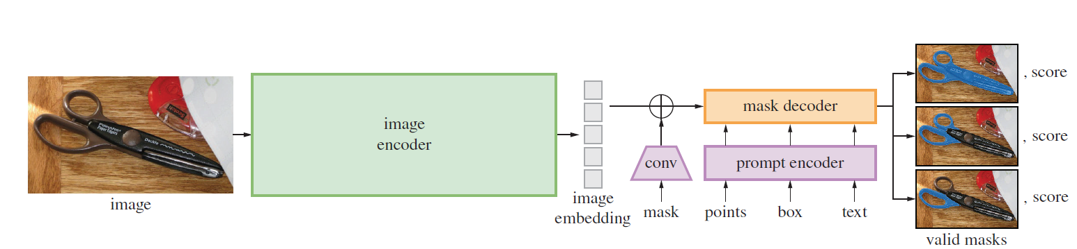
Segment Anything (SAM)-Model
SAM Model:
The model includes an image encoder, prompt encoder, and mask decoder.
Notes:
模型
模型包含了一个图像编码器 (image encoder)，提示编码器 (prompt encoder)和掩码解码器 (mask decoder)，如下图所示。

Slide 18
Segment Anything (SAM)
Image encoder
Pretrain a ViT using the MAE model to support high-resolution image input.
The position of the image encoder is before the prompt encoder, and each image is only run once.
Input image(c, h,w) is scaled to 1024 based on the long edge, and zeros are added if the short edge is not enough. Finally, an image of (c, 1024, 1024) is obtained, which is down-sampled by 16 times using the image encoder. The size of the feature is (256,64,64).
Notes:
(1) 图像编码器（image encoder）
利用MAE模型预训练一个ViT，支持高分辨率的图像输入。Image encoder的位置在prompt encoder之前，对每张图像只运行一次。
输入(c,h,w)的图像，对图像进行缩放，按照长边缩放成1024，短边不够就补零,最终得到(c,1024,1024)的图像，经过image encoder，得到对图像16倍下采样的feature，大小为(256,64,64)。

Slide 19
Segment Anything (SAM)
(2) prompt encoder
Input prompt encoder is divided into two categories: sparse (dots, boxes, text) and dense (masks)
Point: mapped to a 256 dimensional vector, containing positional encoding representing the position of the point, plus 2 learnable embeddings representing the foreground/background of the point.
Box: Use an embedding pair to represent (1) learnable embedding representing the upper left corner (2) learnable embedding representing the lower right corner.
Text: Encoding text using the CLIP model.
Mask: Use a mask at 1/4 resolution of the input image, and then use (2,2) convolutional kernels, Stride-2 outputs channels 4 and 16, and then uses (1,1) convolutional kernels to increase the channel to 256. Mask and image embedding are multiplied by element wise.
Notes:
(2) 提示编码器（prompt encoder）
输入分成2类：稀疏的 (点，框，文本)，稠密的（掩码）
点（point）: 映射到256维的向量，包含代表点位置的 positional encoding，加2个代表该点是前景/背景的可学习的embedding
框（box）: 用一个embedding pair表示（1）可学习的embedding代表左上角（2）可学习的embedding代表右下角
文本（text）：通过CLIP模型进行文本编码
掩码（mask）: 用输入图像1/4分辨率的mask，然后用(2,2)卷积核，stride-2输出channel为4和16，再用(1,1)卷积核将channel升到256. mask 和image embedding通过element-wise相乘

Slide 20
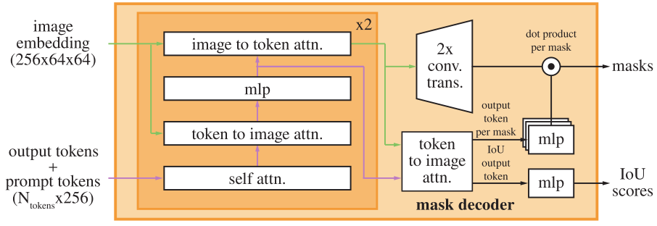
Segment Anything (SAM)
(3) mask decoder
Insert a learnable token into prompt embeddings for the output of the docoder.
Prompt tokens+output tokens for self attn,
Use the obtained token and image embedding for cross attn (token as Q)
Point wise MLP update token
Use image embedding and (3) tokens for cross attention (image embedding as Q)
Repeat the above steps twice, then connect ATTN through residuals, and finally output masks and IOU scores.
Notes:
在prompt embeddings中插入一个可学习的token，用于docoder的输出。
（1）prompt tokens+output tokens进行self attn,
（2）用得到的token和image embedding进行 cross attn（token作为Q）
（3）point-wise MLP 更新token
（4）用image embedding和（3）的token进行cross atten（image embedding作为Q）
重复上述步骤2次，再将attn通过残差进行连接，最终输出masks和iou scores。

Slide 21
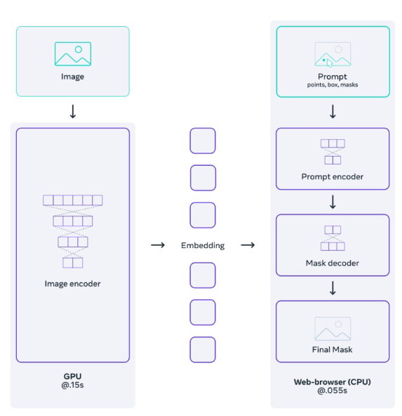
Segment Anything (SAM)
Efficient model design:
Image encoder: with multiple parameters and high computational complexity.
Prompt encoder and mask decoder: fewer parameters and less computational complexity.
Notes:
高效的模型设计：
图像编码器：参数多，计算量大
提示编码器和掩码解码器：参数少，计算量小

Slide 22
02
SAM Experiment

Slide 23
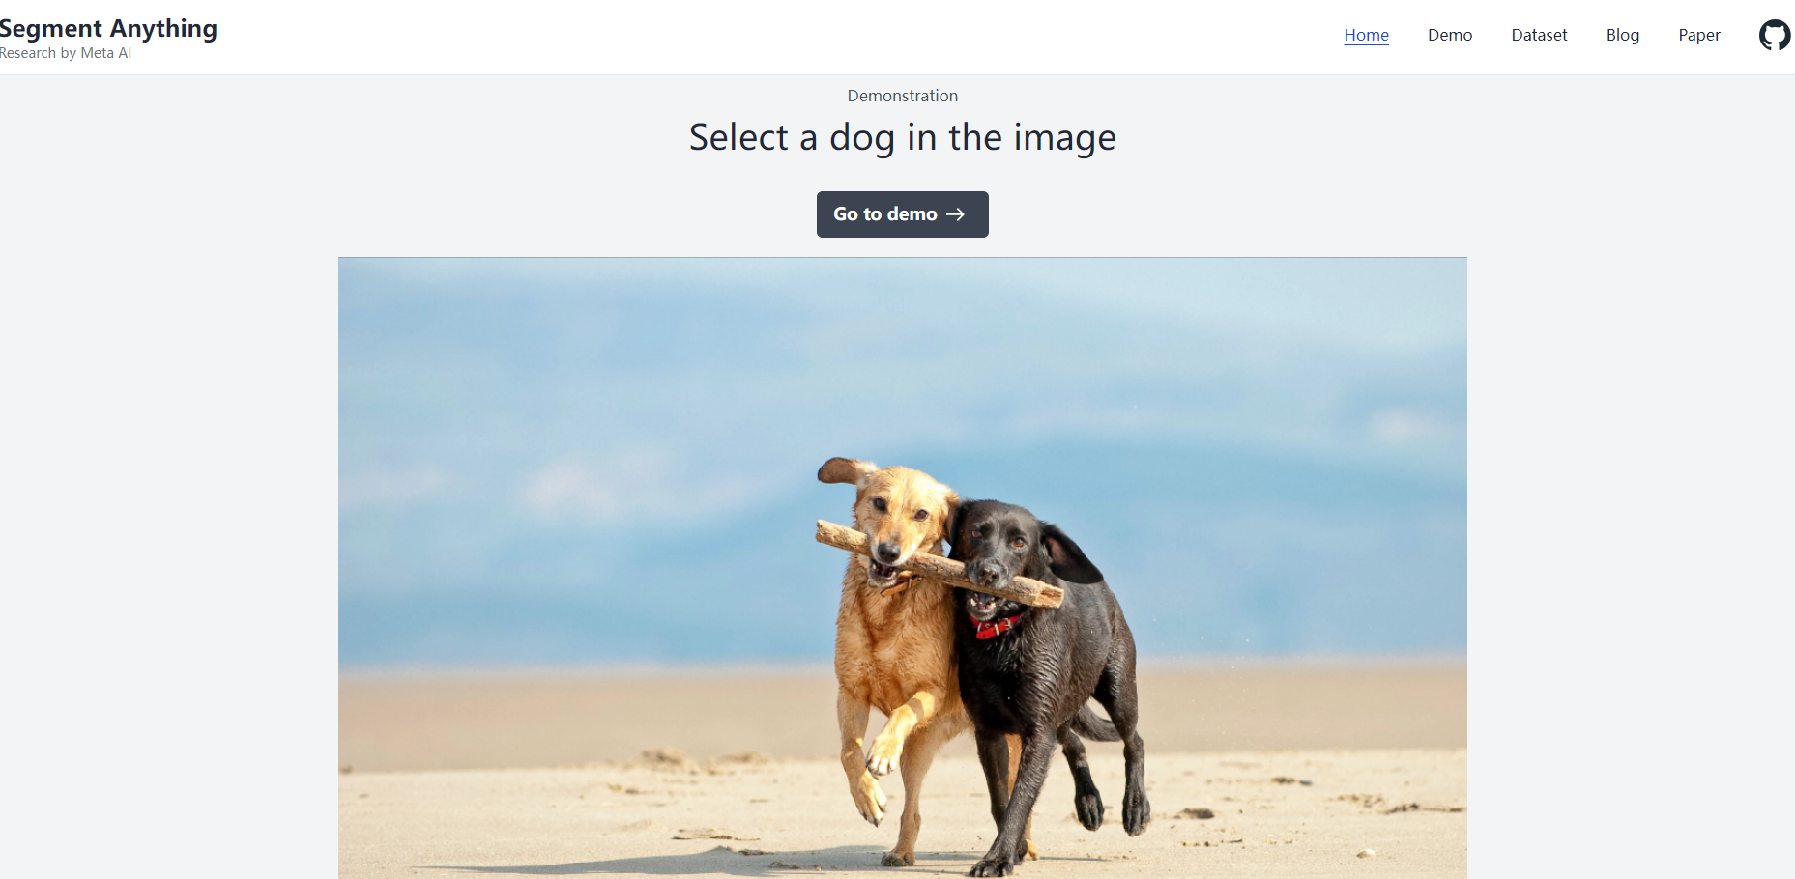
Exercise 1: Using the SAM model for image segmentation
https://segment-anything.com/
Notes:
练习1：使用SAM模型进行图像分割Exercise 1: Using the SAM model for image segmentation

Slide 24
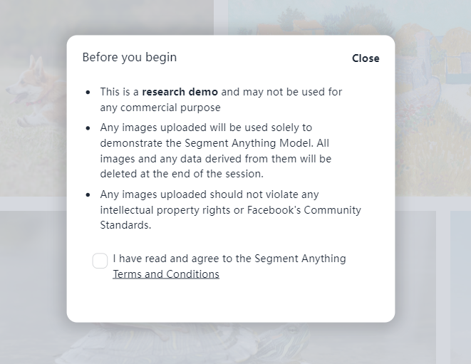
Exercise 1: Using the SAM model for image segmentation
https://segment-anything.com/
打对勾

Slide 25
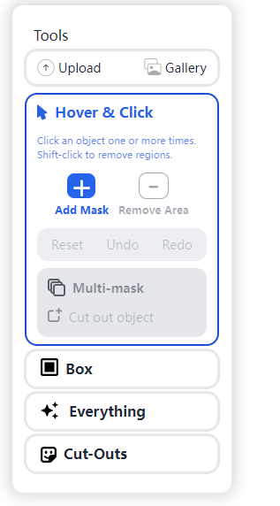
Exercise 1: Using the SAM model for image segmentation
https://segment-anything.com/

Slide 26
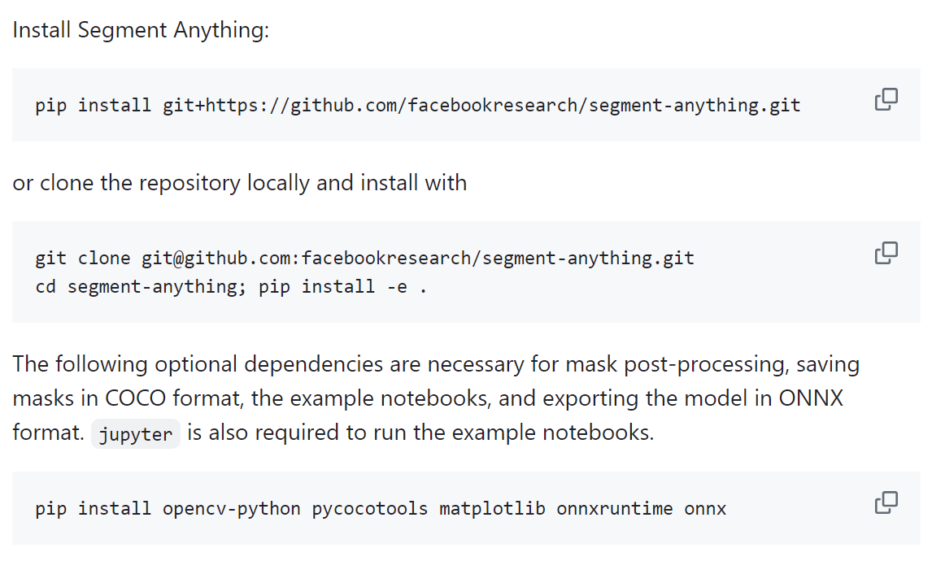
Exercise 2: Installing and configuring the SAM environment
Github：https://github.com/facebookresearch/segment-anything

Slide 27
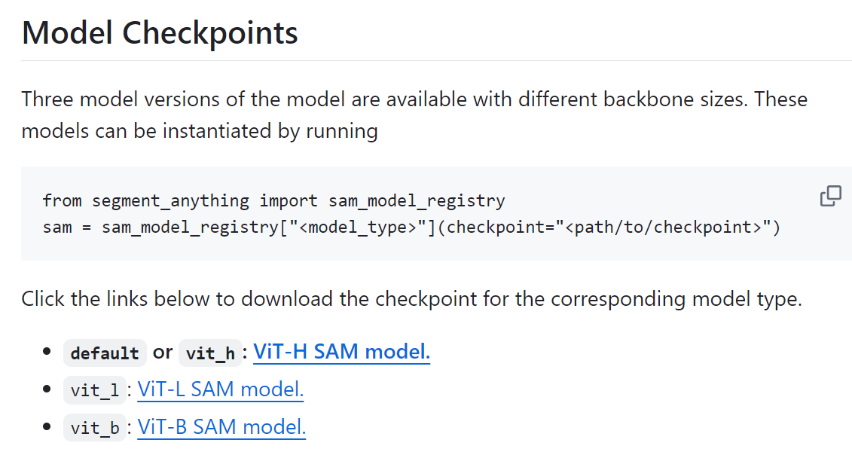
Exercise 2: Installing and configuring the SAM environment
Github：https://github.com/facebookresearch/segment-anything
In here, please use vit_h model：sam_vit_h_4b8939.pth

Slide 28
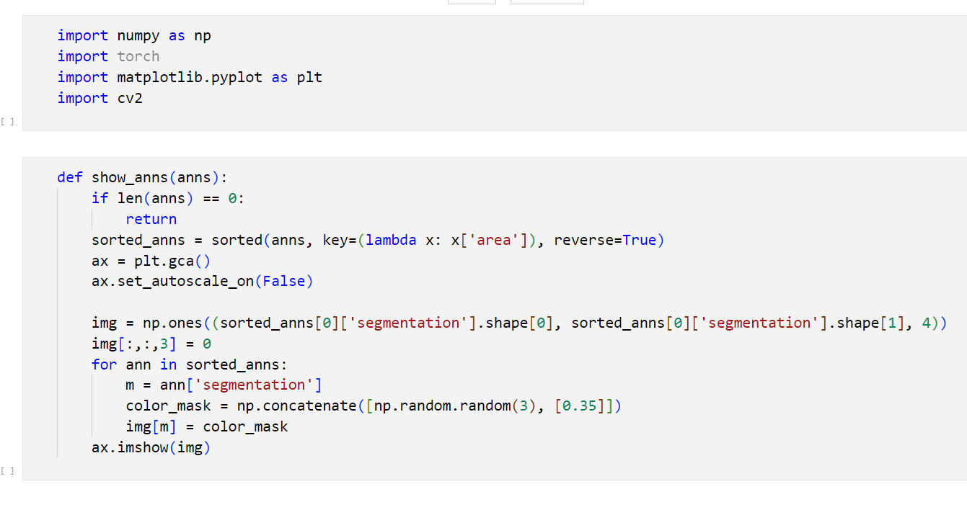
Exercise 3：Using SAM atuo generate image mask
automatic_mask_generator_example.ipynb
Notes:
练习3：使用SAM自动生成图像掩码

Slide 29
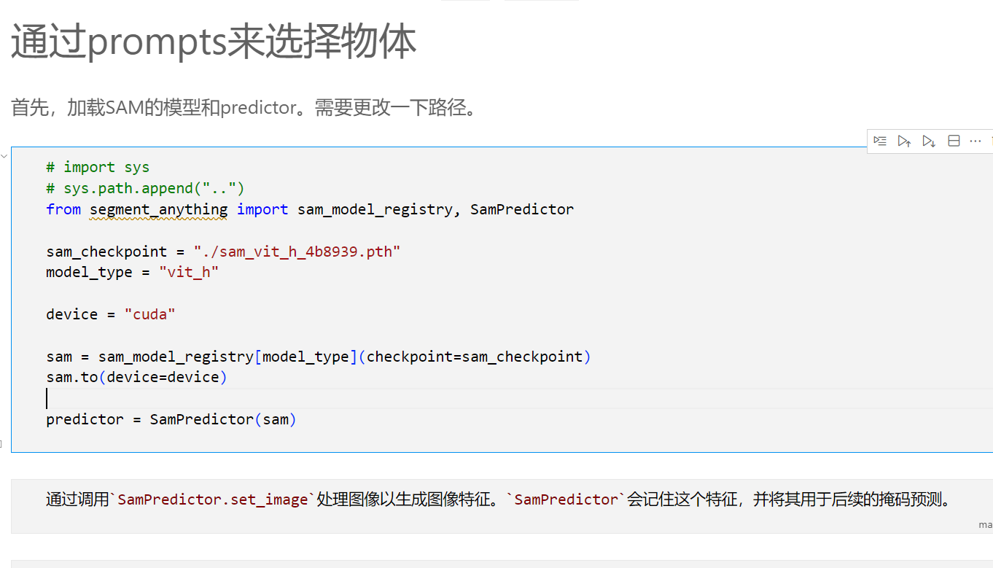
Exercise 4：using prompts to choose objects
predictor_example.ipynb

Slide 30
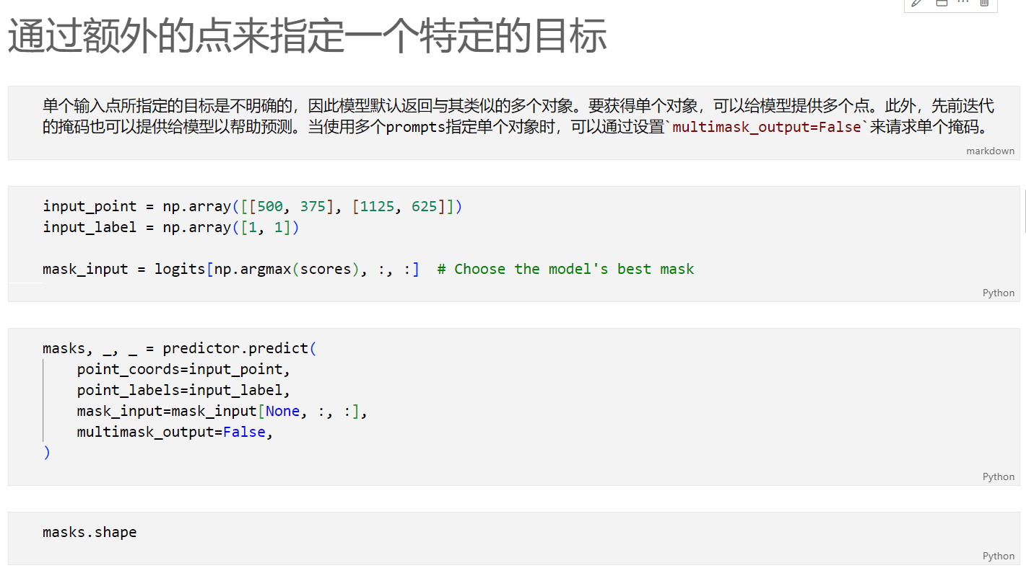
Exercise 5: Specify a specific goal through additional points
predictor_example.ipynb
Notes:
练习5：通过额外的点来指定一个特定的目标

Slide 31
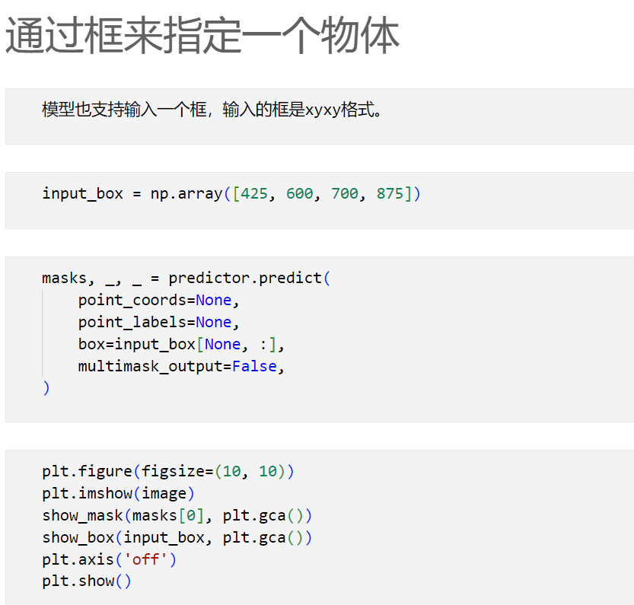
Exercise 6: Specify an object through a box
predictor_example.ipynb
Notes:
练习6：通过框来指定一个物体

Slide 32
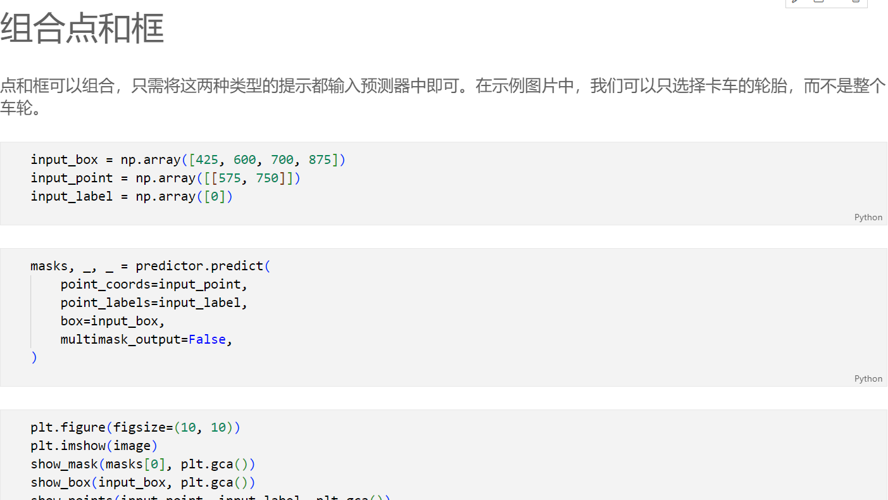
Exercise 7: Combining Points and Boxes
predictor_example.ipynb

Slide 33
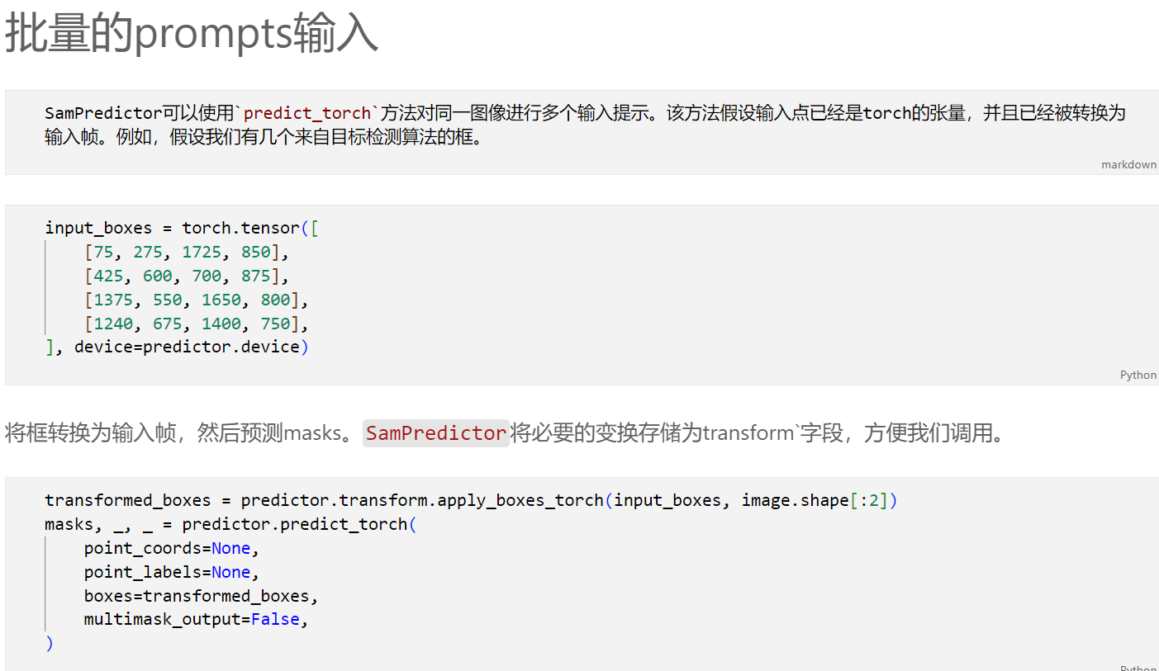
Exercise 8: Batch prompts input
predictor_example.ipynb
Notes:
练习8：批量prompts输入

Slide 34
Exercise 9: End to end batch processing
predictor_example.ipynb

Slide 35
03
SAM Application

Slide 36
SAM application
Since the release of the SAM model, there have been more and more secondary applications and derivative projects based on SAM, which have been applied to various tasks:
图像修复( image inpainting)
图像编辑（ image editing）
目标检测（objects detection）
图像标注（Image Caption）
视频跟踪(object tracking)
3d检测 (3D object detectioln)
......
Notes:
自从SAM模型发布以来，基于sam的二次应用及衍生项目越来越多，将其应用于各种任务:
图像修复( image inpainting)
图像编辑（ image editing）
目标检测（objects detection）
图像标注（Image Caption）
视频跟踪(object tracking)
3d检测 (3D object detectioln)
......

Slide 37
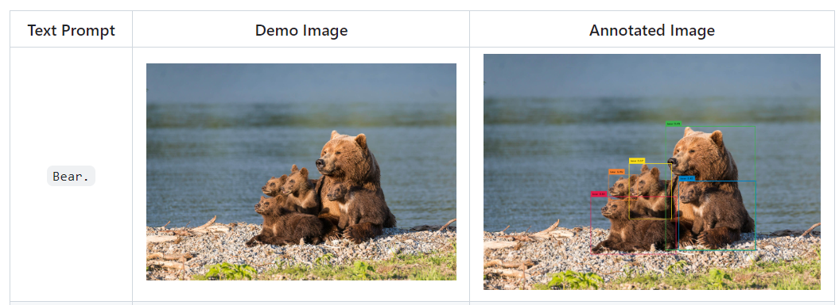
SAM application
1. Image segmention
（1）Grounded Segment Anything：GroundingDINO + SAM = Grounded-SAM
[GroundingDINO]： Detecting through text ：

Slide 38
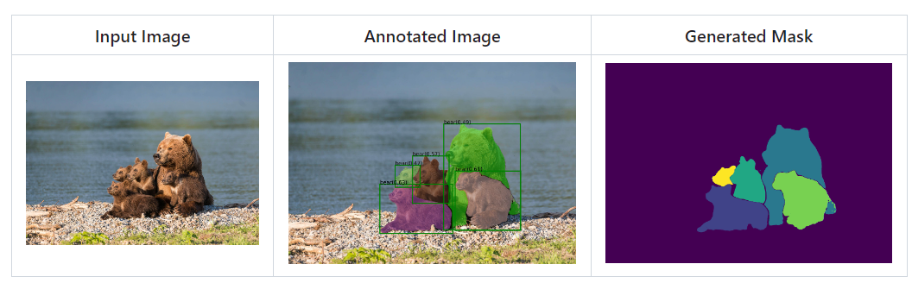
SAM application
1. Image segmentation
（1） Grounded Segment Anything： GroundingDINO + SAM = Grounded-SAM
[Grounded-SAM]: Obtain the detection box through text, then input the detected box into Sam to obtain the mask.
Notes:
通过文本得到检测box，然后将检测的box输入到sam，得到mask。

Slide 39
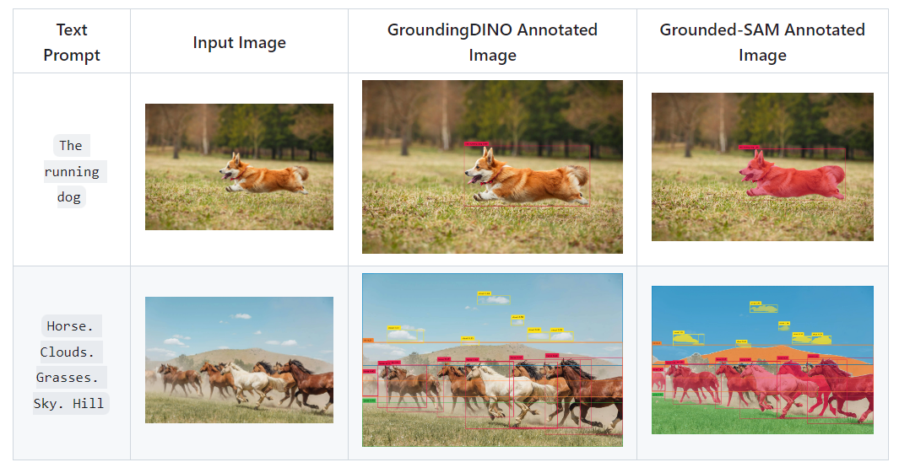
SAM application
Notes:
Obtain the detection box through text, then input the detected box into Sam to obtain the mask.通过文本得到检测box，然后将检测的box输入到sam，得到mask。

Slide 40
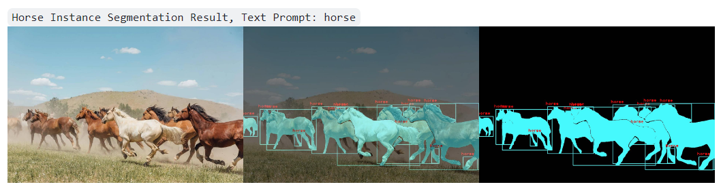
SAM Application
1. Image segmentation
（2）Segment Anything with Clip： CLIP + SAM
Main process: Sam generates a mask, then cuts all objects to obtain the image feature after the drop and the query feature of the clip. The score of the two is calculated and matched.
Notes:
主要流程：sam生成mask，然后裁切所有object，得到crop后的image feature，和clip的query feature，计算二者的score，进行匹配。

Slide 41
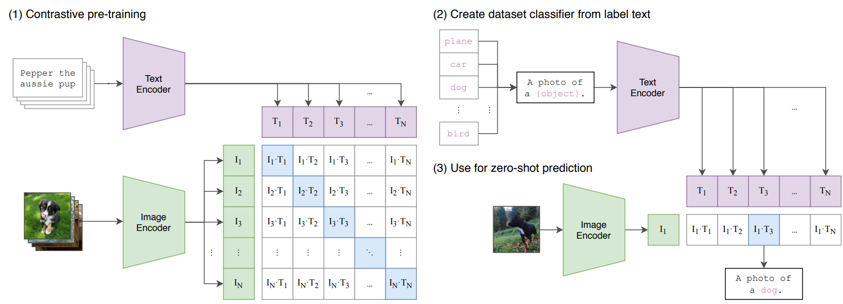
SAM application
1. Image segmentation
（2）Segment Anything with Clip： CLIP + SAM
CLIP model
Notes:
主要流程：sam生成mask，然后裁切所有object，得到crop后的image feature和clip的query feature，计算二者的score，进行匹配。

Slide 42
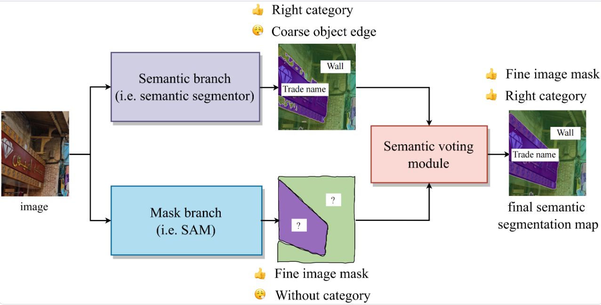
SAM Application
1. Image segmentation
（3）Semantic-Segment-Anything： semantic segmentor + SAM
A segmented branch is used to obtain a mask with rough boundaries but accurate categories, and another branch predicts an unlabeled mask through Sam. The semantic voting module (prunes the corresponding region of the mask to obtain the category, and takes the top-1 category as the category of the mask) is used to merge the masks and labels of the two branches to obtain a labeled mask.
Notes:
主要流程：通过一个分割的分支得到边界粗糙但类别准确的mask，然后另一个分支通过sam预测无标签的mask，通过语义投票模块（裁剪出mask对应区域得到类别，取top-1的类别作为mask的类别），合并2个分支的mask和标签，得到有标签的mask 。

Slide 43
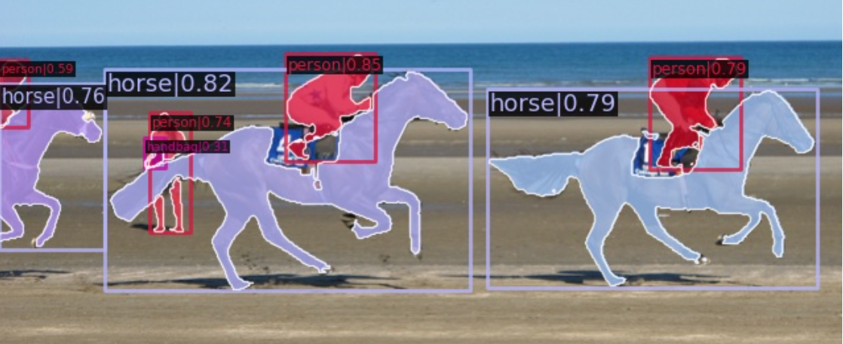
SAM Application
1. Image segmentation
（4）Prompt-Segment-Anything： Object Detector + SAM
Main flowchart：Integrate the detection model, first use the detection model to obtain the label and box, and then use the box as the prompt to obtain the mask of the instance.
Notes:
主要流程：集成检测模型，先用检测模型得到label和box，然后用box作为prompt，得到instance的mask。

Slide 44
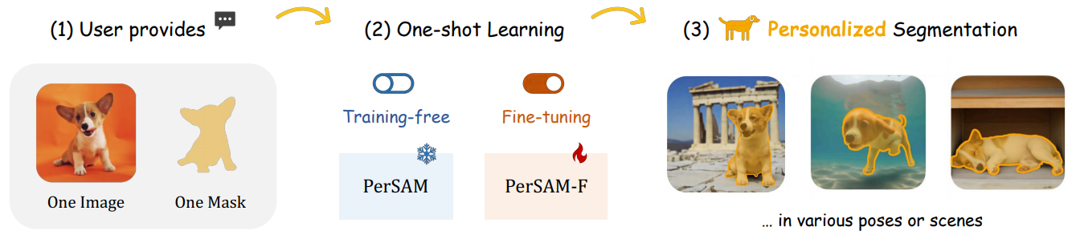
SAM Application
1. Image segmentation
（5）[Personalize-SAM]: Given only one image with a reference mask, PerSAM can segment specific targets in other images or videos without any training, such as pet dogs. Fine tuning was also provided, but only two parameters were trained.
Notes:
仅给定一张带有参考mask的图像，PerSAM 无需任何训练即可在其他图像或视频中分割特定的目标，例如宠物狗。也提供了微调，但是只训练了2个参数。

Slide 45
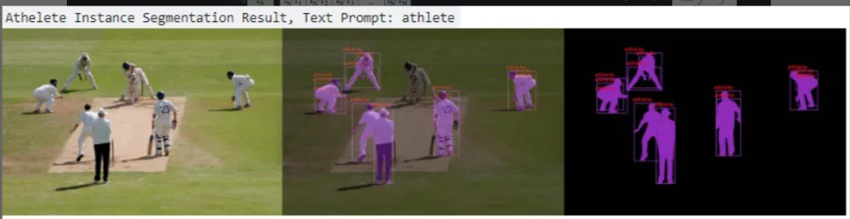
SAM Application
2. Object detetion
（1）CLIP + SAM
Main process: Sam generates a mask, then cuts all objects to obtain the image feature after the drop and the query feature of the clip. The score of the two is calculated and matched.
Notes:
主要流程：sam生成mask，然后裁切所有object，得到crop后的image feature和clip的query feature，计算二者的score，进行匹配。

Slide 46
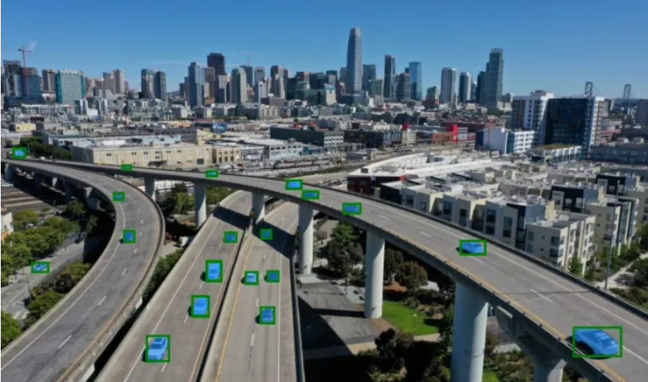
SAM Application
2. Object detection
（2）video object detection：YOLOv5/v8 + SAM

Slide 47
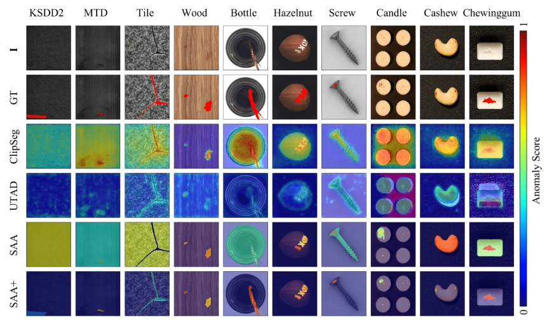
SAM Application
2. Object detection
(3) Anomaly detection: SAA plus: Combined with GroundDino, to address the ambiguity in language models when detecting "anomalies" or "defects", cross prompts are introduced by introducing professional knowledge and image context information to improve detection performance.
Notes:
(3) 异常检测：SAA-plus：结合GroundDino，针对语言模型在检测“异常”或“缺陷”时存在歧义，通过引入专业知识和图像上下文信息，进行交叉prompt，提高检测性能。

Slide 48
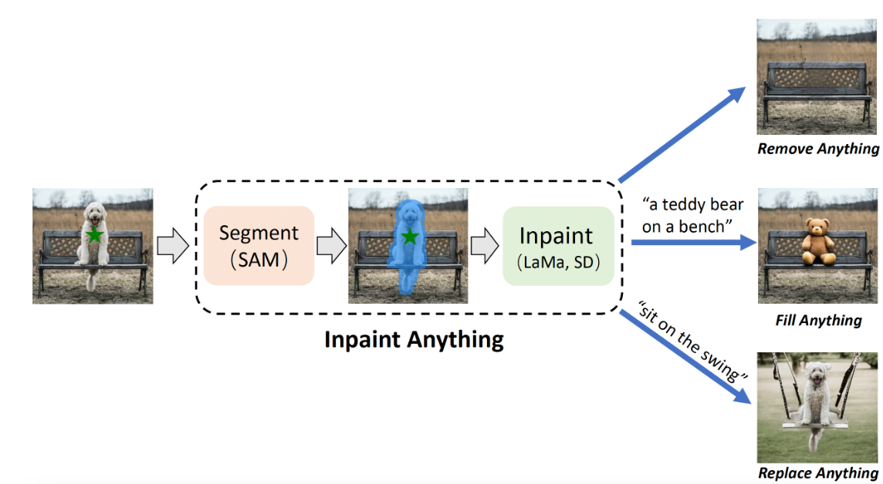
SAM appliction
3. Image restoration
Inpaint-Anything：SAM + LaMA/SD
Including removing targets, filling targets, replacing targets, etc.
Notes:
3. 图像修复
Inpaint-Anything：SAM + LaMA/SD
包含移除目标，填充目标，替换目标等。

Slide 49
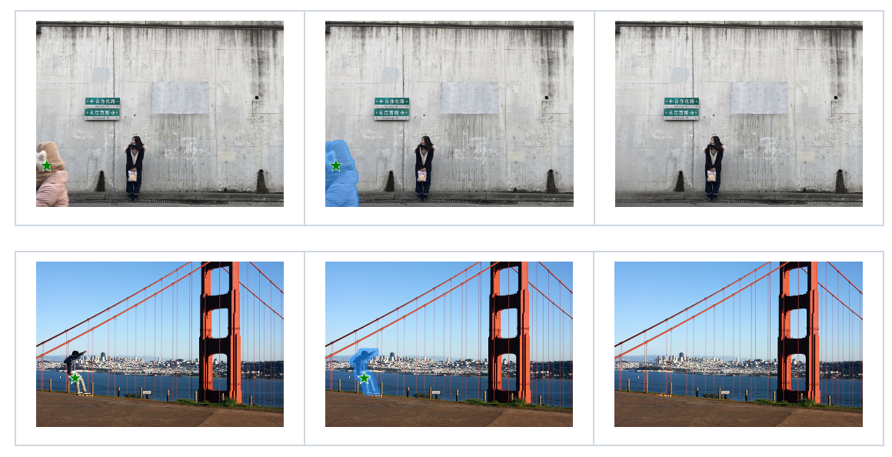
SAM Application
3. Image restoration
Inpaint-Anything：SAM + LaMA/SD
Including removing targets, filling targets, replacing targets, etc.

Slide 50
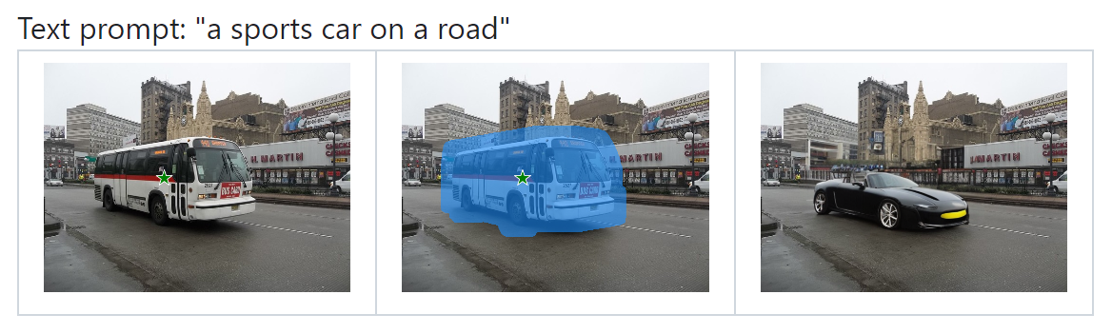
SAM Application
3. Image restoration
Inpaint-Anything：SAM + LaMA/SD
Including removing targets, filling targets, replacing targets, etc.

Slide 51
SAM application
Other applications of SAM:
Annotation tools
Image generation
Video tracking
Point cloud segmentation
3D reconstruction
…….
Notes:
SAM的其它应用：
标注工具
图像生成
视频跟踪
点云分割
3D重建
......

Slide 52
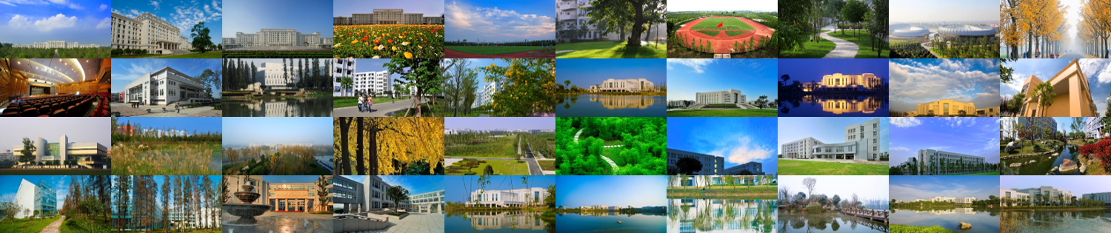
谢谢！

